Slide 1
VISHWADEEP ENTERPRISES

Slide 2
VISHWADEEP ENTERPRISES
HISTORY
2006 Set up with Press shop (Pressing Range 20T to 50T)
2007 Set Up with Press Shop (Pressing Range 20 T to 100 T)
- Certified With Quality Management System ISO : 9000
2008 Setup with Press shop with Fabrication
- Set up with own Tool Room Activity
- Started Mfg seating Mechanism ,Fuel Tank Cap Assy
2009 Set up added with Pressing up to 200 T
- Added variety seating Mechanisms range.
2010 Focused technology based Engg development
- Customized Value Engg & Value Added (VEVA ) Developments
2011 Started Mfg critical Mechanism ,Proprietary Assembly with customers needs
2017 Added 250 T power Presses 2 nos .

Slide 3
VISHWADEEP ENTERPRISES

Slide 4
VISHWADEEP ENTERPRISES
Autoparts
Fuel Tank Cap Assy
Deep Draw Parts
Seating Mechanisms used in
Commercial & Passenger Vehicles
Torsional couplings
Flexible Coupling
Off Road Vehicle Seating systems
Silencer Assy Parts
Power Transmitting Equipments
Products

Slide 5
VISHWADEEP ENTERPRISES
Manufacturing Facility
Power presses
1) 20 T- 1 No
2) 30 T- 1 No
3) 50 T- 2 No
4) 75 T - 1 No
5) 100 T – 2 No
6) 150 T- 2 No
7) 200 T- 2 No
8) 250 T – 2 Nos
Hydraulic Press
1) 150 T – 1 Nos
Welding
1) Co2 welding- 6 No- 300 Amp
2) Spot Cum Projection welding – 1 No- 15 KVA
Tool Room
1) Lathe – 4.5” -1 Nos
2) Surface Grinder-1Nos
3) Drilling Machine – 2 Nos
4) Milling Machine -1 No
5) VMC -1000(x)-500 (y)-500 (z) – 3 Nos

Slide 6
VISHWADEEP ENTERPRISES
LIST OF VALUABLE CUSTOMERS
TATA MOTORS Ltd.
LEAR AUTOMOTIVES INDIA Pvt Ltd .
CVG SEATING India Pvt Ltd .
CIKAUTXO India Pvt Ltd .
COOPER STANDARD Pvt Ltd.
RIETER India Pvt Ltd.

Slide 7
VISHWADEEP ENTERPRISES
LIST OF VALUABLE CUSTOMERS
TATA INTERNATIONAL DLT Pvt. Ltd.
HARITA SEATING SYSTEMS Pvt. Ltd.
VIJAYJYOT SEATING SYSTEMS Pvt. Ltd.
AMERICAN AXLES India Pvt. Ltd.
MAHARASHTRA AGRO Ind. Devp. Corp.
DALI & SAMIR ENGG. Pvt .Ltd.
AVI Worldwide Pvt Ltd.

Slide 8
VISHWADEEP ENTERPRISES
Products used in
Commercial Vehicle
Off road vehicle
Passenger vehicle
Textile Machines
Seat Mechanism
Slider Assy Mechanism
Height Assy Mechanism
Suspension Mechanism
Silencer Assy
Fuel Tank Assy
Torsional Couplings for
Servo motors
Stepper motors
Power Transmitting Equipments
Deep Draw Parts
Shock Absorber Assy Cups

Slide 9
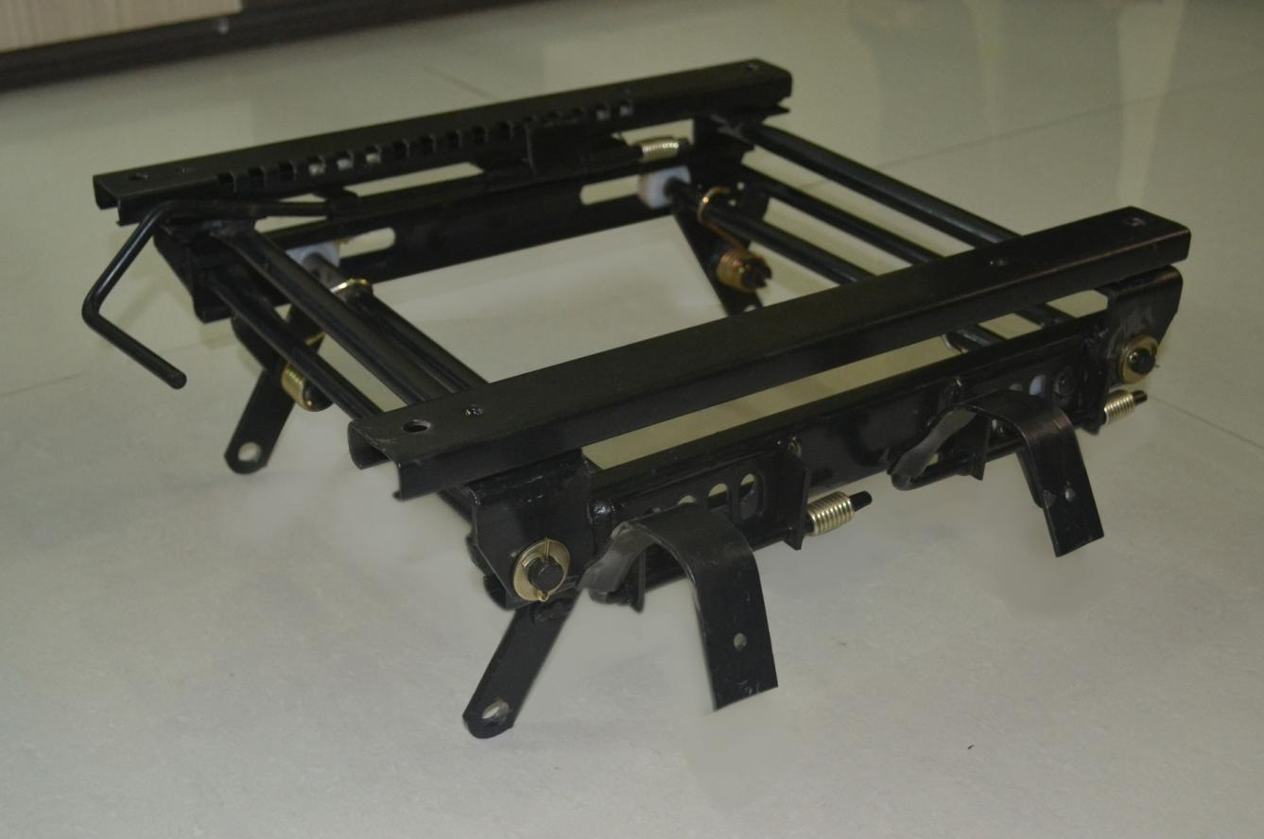
VISHWADEEP ENTERPRISES Assy Height Adjuster ( Winger ) Customer:- TATA MOTORS Ltd.

Slide 10
VISHWADEEP ENTERPRISES Key Product :- Assy Height Adjuster ( Mahindra Truck ) Customer:- Lear Automotive Ind.Pvt.Ltd

Slide 11
VISHWADEEP ENTERPRISES Key Product :- Assy Slider For Cinema Theatre Customer:- CVG Seating Ind.Pvt Ltd

Slide 12
VISHWADEEP ENTERPRISES Key Product :- Slider Assy for Cinema Theatre Customer:- CVG Seating Ind.Pvt Ltd

Slide 13
VISHWADEEP ENTERPRISES Key Product :- Suspension Assy Customer:- CVG Seating Ind.Pvt Ltd

Slide 14
VISHWADEEP ENTERPRISES Key Product :- Slider Assy Customer:- CVG Seating Ind.Pvt.Ltd

Slide 15
VISHWADEEP ENTERPRISES Key Product :- Slider Assy For Voltas Customer:- Harita Seating Systems Pvt Ltd.

Slide 16
VISHWADEEP ENTERPRISES Key Product :- Slider Assy For Godrej Customer :- Harita Seating Systems Pvt Ltd.

Slide 17
VISHWADEEP ENTERPRISES Key Product :- Hand Break Tensioner Assy Customer:- Tata Dlt Intl Pvt.Ltd.

Slide 18
VISHWADEEP ENTERPRISES Key Product :- Slider Assy For Tata Sumo Customer:- CVG Seating Pvt.Ltd

Slide 19
VISHWADEEP ENTERPRISES Key Product :- Slider Assy For ApeTruck Customer:- CVG Seating China .

Slide 20
VISHWADEEP ENTERPRISES Key Product :- Double Locking Height Adjuster Customer :- CVG Seating Ind Pvt.Ltd.

Slide 21
VISHWADEEP ENTERPRISES Key Product :- Single Locking Height Adjuster Customer:- CVG Seating Ind.Pvt.Ltd.

Slide 22
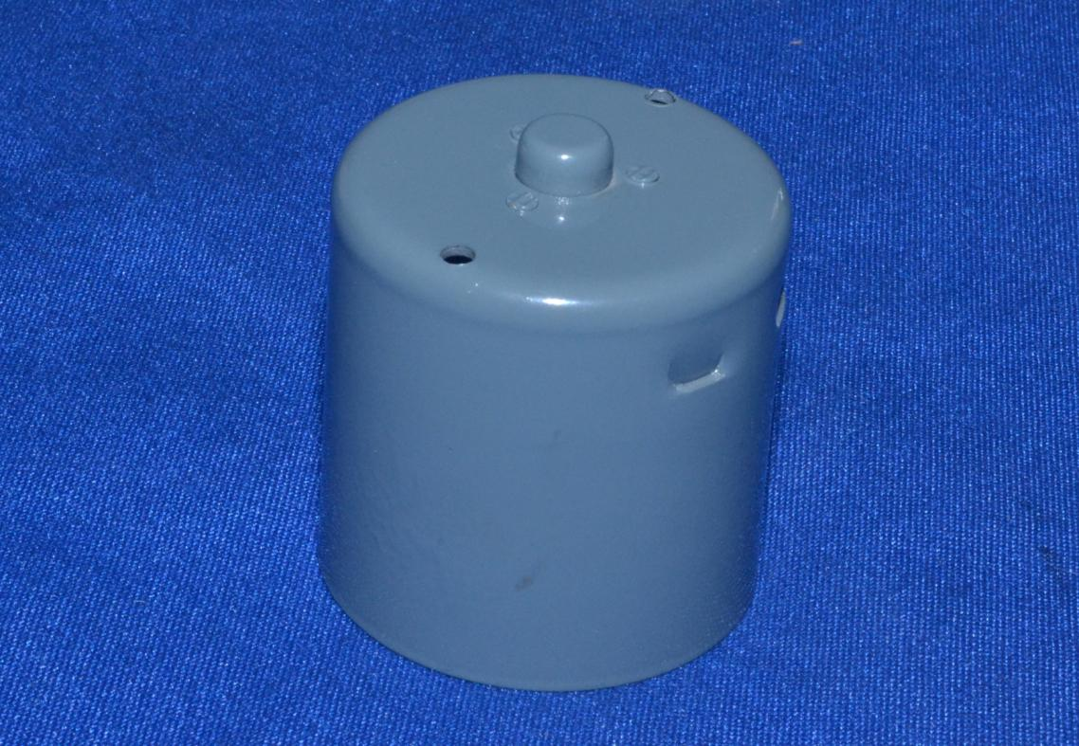
VISHWADEEP ENTERPRISES Product : - Deep Draw Housing Customer:- Prabha Engg Pvt.Ltd.
.

Slide 23
VISHWADEEP ENTERPRISES Key Product :- Deep Draw Housing Assy Customer:- Prabha Engg Pvt.Ltd.

Slide 24
VISHWADEEP ENTERPRISES Key Product :- Folding Housing Wiper Motor Customer :- Prabha Engg Pvt.Ltd.

Slide 25
VISHWADEEP ENTERPRISES Product :- Deep Draw Housing Customer:- Prabha Engg Pvt.Ltd.

Slide 26
VISHWADEEP ENTERPRISES Product :- Mounting Bracket Wiper Assy Customer:- Prabha Engg Pvt.Ltd.

Slide 27
VISHWADEEP ENTERPRISES Product :- Manifold Cover Plate Wiper Assy Customer:- Prabha Engg Pvt.Ltd.

Slide 28
VISHWADEEP ENTERPRISES Product :- Deep Draw Cup for Shock up Assy Customer:- AVI Worldwide Pvt Ltd.

Slide 29
VISHWADEEP ENTERPRISES Product :- Deep Draw Cup for Shock up Assy Customer:- AVI Worldwide Pvt Ltd.

Slide 30
VISHWADEEP ENTERPRISES Key Product :-Deep Draw Cup Customer :- Dali & Samir Engg Pvt.Ltd.

Slide 31
VISHWADEEP ENTERPRISES Product :- Silencer Assy Inlet Pipe Customer :- Dali & Samir Engg Pvt.Ltd

Slide 32
VISHWADEEP ENTERPRISES Product :-Silencer Front Cup Customer :- Dali & Samir Pvt.Ltd

Slide 33
VISHWADEEP ENTERPRISES Product :- Stainer Assy Customer :- Oil Stainer

Slide 34
VISHWADEEP ENTERPRISES Product:-Fuel Tank Cap Assy Customer :- Dali & Samir Engg Pvt.Ltd

Slide 35
VISHWADEEP ENTERPRISES Product:-Fuel Tank Cap Assy Customer :- Dali & Samir Engg Pvt.Ltd

Slide 36
VISHWADEEP ENTERPRISES Product:-Fuel Tank Cap Assy (Ashok Leyland) Customer :- Dali & Samir Engg Pvt.Ltd.

Slide 37
VISHWADEEP ENTERPRISES Product :-Latch Assy Customer:- Kanda Motors Pvt.Ltd.

Slide 38
VISHWADEEP ENTERPRISES Product :- Rear Cover for Axle Customer:- American Axles Ind.Pvt.Ltd.

Slide 39
VISHWADEEP ENTERPRISES Flexible Couplings

Slide 40
VISHWADEEP ENTERPRISES
THANK YOU FOR VISITING

